Slide 1
Addressing modes
Immediate Addressing Mode
Register Addressing Mode
Direct Addressing Mode
Indirect Addressing Mode
Indexed Addressing Mode

Slide 2
8051 Architecture’s
Memory Structures

Slide 3
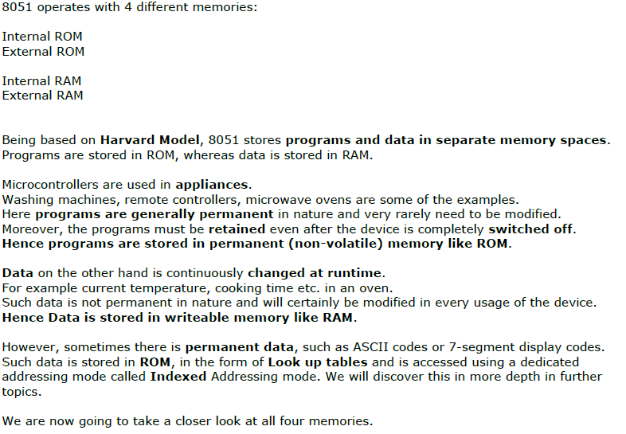
Notes:
Kkkk

Slide 4
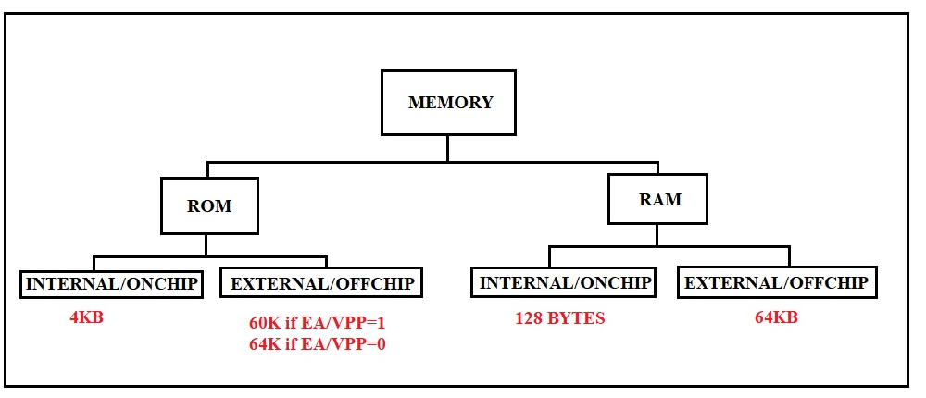
mov,add,xch,orl – internal data memory access
movx – external data memory
movc – code memory access (internal+external)

Slide 5
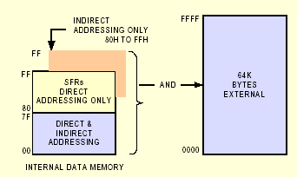
Data memory

Slide 6
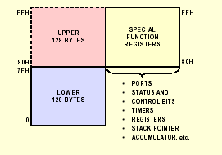
Internal Data memory

Slide 7
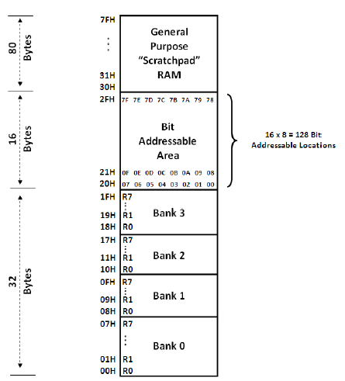
Bytewise Accessible :
Direct
& Indirect
Bytewise Accessible:Direct,Indirect.
Bitwise direct
Byteswise Accessible,
Register ,
Directly,
& Indirect

Slide 8
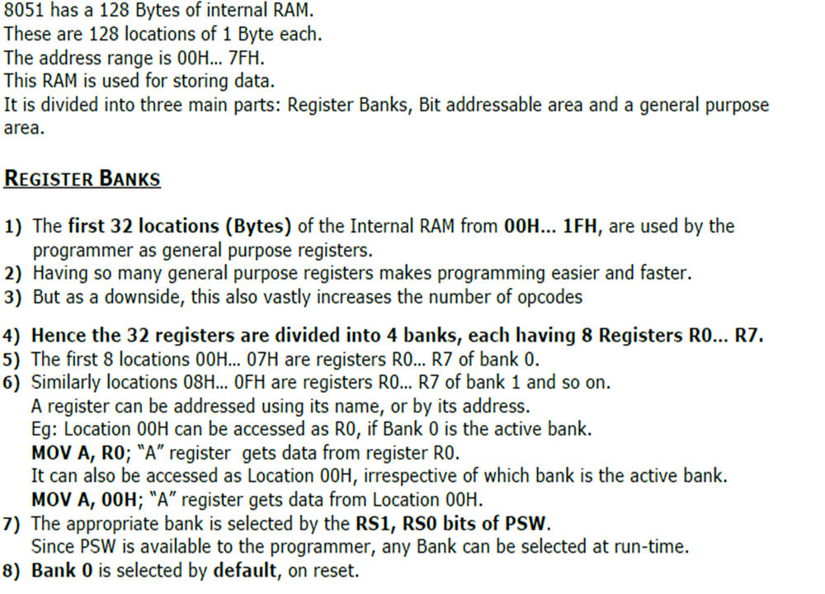

Slide 9
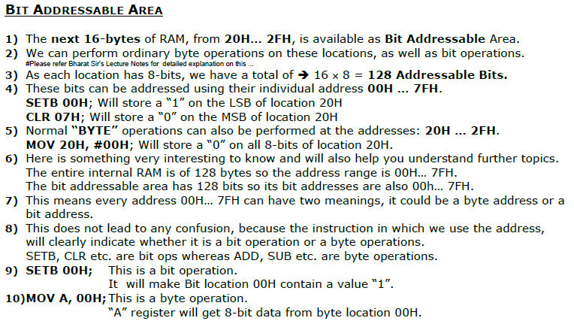

Slide 10
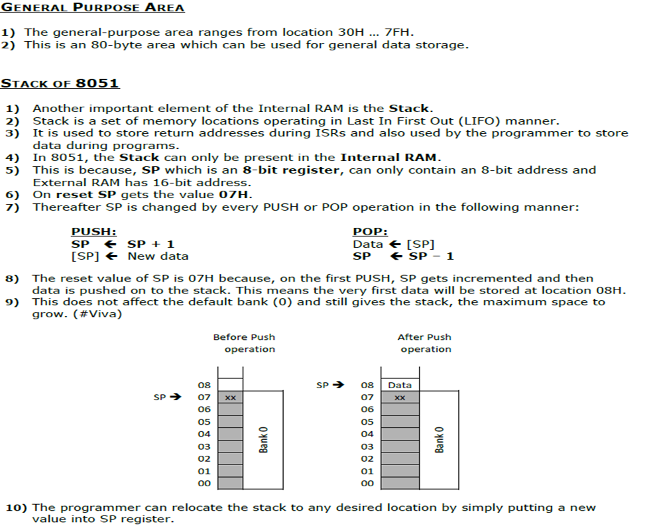

Slide 11
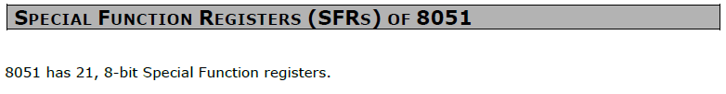
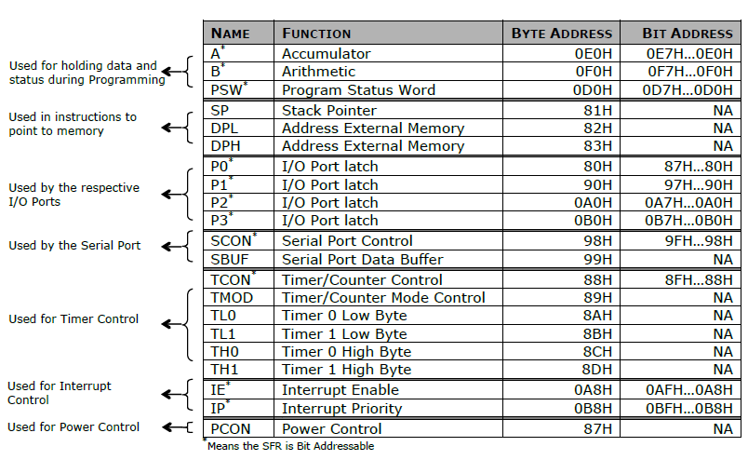
www.vectorindia.org

Slide 12
Special Function Register Map
Bit Addressable
F8
F0 B
E8
E0 ACC
D8
D0 PSW
C8
C0
B8 IP
B0 P3
A8 IE
A0 P2
98 SCON SBUF
90 P1
88 TCON TMOD TL0 TL1 TH 0 TH1
80 P0 SP DPL DPH PCON
www.vectorindia.org

Slide 13

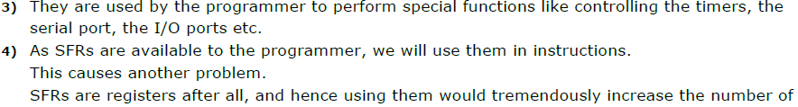
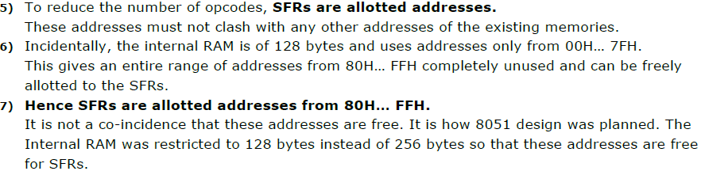

Slide 14
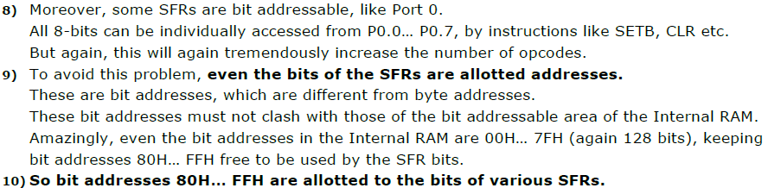
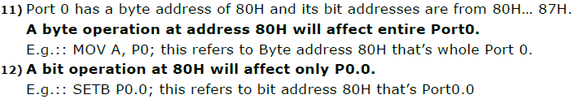

Slide 15
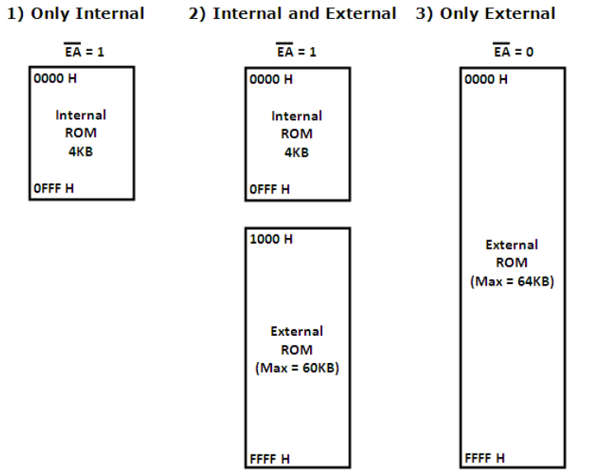

Slide 16
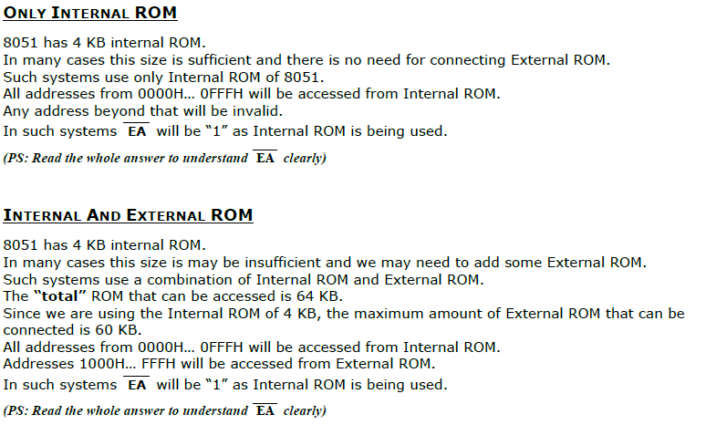

Slide 17
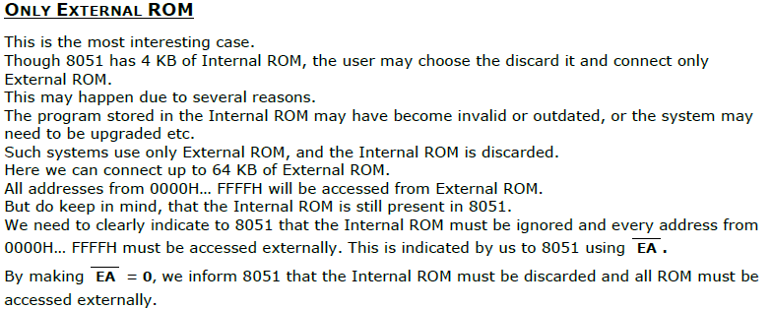
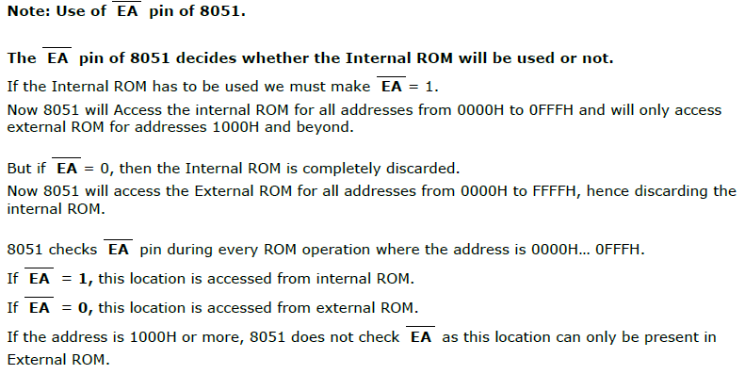

Slide 18
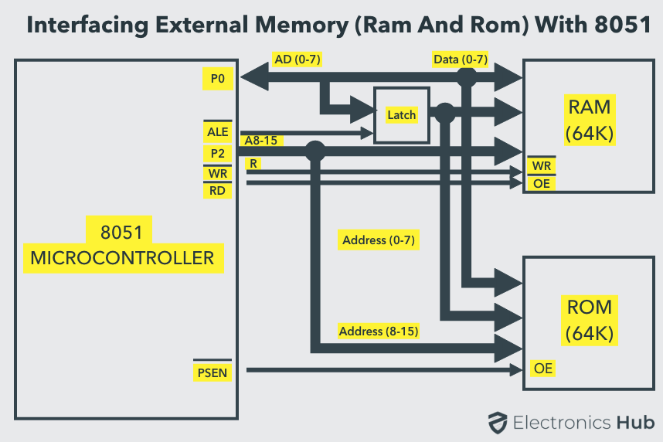

Slide 19
